Slide 1
E205F Preparing for IELTS Unit 5 (Task 2) 1
Hazal WONG
hatwong@ouhk.edu.hk

Slide 2
Extra: Marking Criteria
Task Achievement
Coherence and Cohesion
Answer the question fully/ no off topic
Use of connectives/ flow of ideas/ structure
Lexical Resources
Grammatical Range and Accuracy
Vocabulary
tense/ spelling/ sentence patterns etc

Slide 3
Task 2: Writing a piece of argumentative prose (p.24)
The second task in the IELTS Writing test is to produce a short piece of argumentative prose.
You may be required to offer a solution to a problem, give an opinion and justify it, present arguments on both sides of an issue, evaluate a point of view or speculate on an issue.
• write in a style appropriate to an academic context;
• give reasons for your answers; and
• include relevant examples from your own knowledge or experience

Slide 4

You will meet with instructions such as:
To what extent do you agree or disagree with this opinion?
What are your opinions on this?
What do you think will happen?
Discuss the arguments for and against this position.
What would be the main effects of following this policy?
Can be +ve OR -ve

Slide 5
Analysing questions (p.24)
In some questions, there may be words that are in clear need of definition:
It seems likely that the main threat to peace and security over the next century will be terrorism.
To what extent do you agree or disagree with this opinion?
Define key terms using your existing/ world knowledge!

Slide 6
The word ‘terrorism’ is a greatly contested one, you need to clarify the term.
Is terrorism an act of violence carried out for political purposes by a non-state agent?
Or is it the use of violence against civilians when there is no declared war?
What is its relation to self defense or justified partisan action against a perceived oppressor?
You not going to be able to solve the difficulties, but need to show an awareness of them and include the question of definition in the essay.
member of a political party

Slide 7
WHAT DOES THE QUESTION IMPLY? ☺
You also need to look out for implied positions and unstated assumptions that you might wish to question:
It seems that many people use drugs recreationally despite all the laws against them. In the light of this fact, the laws should be changed.
To what extent do you agree or disagree with this opinion?

Slide 8
The argument here depends on the view that laws which cannot be enforced strictly or which are broken by otherwise law-abiding people bring discredit on law as a whole and should be repealed.
This is a view held by many, but it is still open to argument.
Perhaps a law can express a social attitude, even if it is not practical to enforce it all the time.
And society should show disapproval of drugs, even if in some places their use is fairly widespread among fairly respectable people.
These are matters for debate and the better essays will raise such issues and not simply accept the statements in the question as given.

Slide 9
Responding to two sides of an issue (p.25)
Sometimes a question presents both sides of an issue and asks you to discuss them.
For example, the question on drugs could be reworded as follows:
Some people believe that drugs are a great social evil and the fight
against their use a high priority. Others think that society should accept
that outlawing them has failed and that some degree of tolerance should
be introduced.
Discuss both points of view and then provide your own opinion on the issue.

Slide 10
In this case, one must be sure to follow the instructions and organize one’s essay accordingly.
One might perhaps develop each point of view a little more fully, explaining the arguments its advocates would be likely to use.
And then express one’s own view, supporting it with relevant analogies or suggesting relevant research.
INTRODUCTION
VIEW 1 + EXPLANATION
VIEW 2 + EXPLANATION
YOUR OPINION + CONCLUSION

Slide 11

Activity 5.11 (p.26)
Read the following questions and decide which words need attention and what underlying issues and assumptions might merit discussion.
Ask yourself whether two contrasting points of view need to be discussed.
Pair work; 4 minutes
We will do Q3 and Q5 only.

Slide 12
Activity 5.11 (Suggested key)
Q3 Envy is a key factor in success and advancement. To what extent do you agree or disagree with this opinion?
What is envy?
Even if the drive to do better and have more is important, are there other equally important drives?
Is the common concept of success and advancement an acceptable one?
The question is full of abstract words and assumptions that need examination.

Slide 13
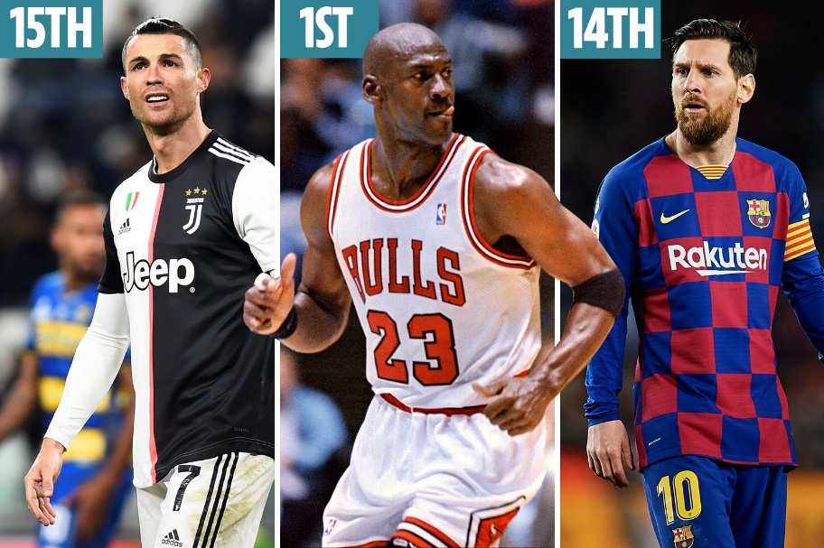
Activity 5.11 (Suggested key)
Q5 Some people believe that sports stars are grossly overpaid, while others argue that their talent and hard work deserves high financial reward. Discuss both points of view and then provide your own opinion on how well sports stars should be paid.
What kinds of sports are we discussing here?
How much money are we talking about here?
Do financial rewards affect motivation of sports athletes?
Are sport stars ‘working harder’ than people in other industries?

Slide 14

The planning process: Brainstorming (p.27)
You have 40 minutes for Task 2 and you will wish to spend some time
thinking and planning before writing.
Just start writing down words, ideas and phrases that come to mind on a particular topic.
Try organizing them to create a rough mind-map to act as the basis for your essay plan.
Everyone’s approach is different; just make sure you PLAN before you WRITE! ☺

Slide 15
Brainstorming: example (extra)
causes of depression
Heredity
Physiology
Psychology
Early experiences in childhood
Mental instability
Sustained anxiety
Low self-esteem/ self-defeating thinking

Slide 16
Step-by-step analysis (p.28)
Brainstorming does not suit everyone. An alternative approach might be to move slowly and thoughtfully through the question.
Some people feel that ‘punishment should fit the crime’. For example, people who commit violent crimes should suffer violence. What are your views on this?
How should we approach this question? ☺
Think of a ‘story line’ > logical linking of your ideas

Slide 17
Step-by-step analysis (p.28)
• Why do people feel this? Probably they feel anger and emotion at crime; they want revenge.
• What does violence for violence involve? Whipping for fighting; execution for murder – but beyond that?
• What does ‘fit the crime’ mean? Should a robber have to give money to the victim? But this only works if the robber has plenty of money.
• What crime would prison be for? Only for kidnappers? But prison keeps criminals out of circulation as well as punishing them.
• What is the role of punishment? Repaying, but also removal from society and re-education

Slide 18
Step-by-step analysis (p.28)
In this way one focuses on the key words and ideas and a structure begins to emerge:
1 Sympathy for the idea on an emotional level. It may work for some simple cases.
2 The idea soon breaks down because it is too narrow. Examples.
3 Need to consider the purpose of punishment. It is wider than repayment for wrong.
4 Conclusion – this is a slogan that may satisfy at some simple level but a proper penal system needs to be far more thoughtful and complex.

Slide 19
Range of ideas (p.29)
In Task 2, you are instructed to write at least 250 words. (~300 words if you can)
You most certainly want to avoid repetition > try to generate more ideas.
You will probably be writing four or five paragraphs with the main content in the middle paragraphs. (2-3 KEY ARGUMENTS)
Education, pollution, climate change, cloning, organ transplants, nuclear
hazards, longevity, unsustainable development, corruption, terrorism and so on.

Slide 20

Activity 5.12 (p.29)
Consider for a couple of minutes words you think should appear in the following essay:
Copyright laws are tools which help multinational corporations maintain monopolies over their products. What are your views on this statement?
2 minutes

Slide 21

Activity 5.12 (Suggested key)
intellectual rights commercial fairness
breach of … developing world
infringement of … music industry
copyright protection pharmaceutical industry
research and development costs return on investment
fair profit consumer rights
brand names royalties

Slide 22
Activity 5.12 Extended Task
Make use of the vocabulary mentioned to form complex sentences.
(not fewer than 15 words)
intellectual rights
…infringement of…
copyright protection
4 minutes

Slide 23
Activity 5.12 Extended Task (Suggested key)
intellectual rights
Quite a number of netizens ignore intellectual rights on the net due to the fact that most activities online could be anonymous. (> 20 words)
…infringement of…
The infringement of intellectual properties from artists of various forms could pose severe harm to their livelihood. (17 words)
copyright protection
Government should advocate copyright protection in greater extent to make sure original works such as literary, drama, musical and artistic works are safeguarded. (>20 words)

Slide 24

Reminders for IELTS Writing Task 2 (extra)
 Never copy the words from your examination paper. Always paraphrase.
 Academic language and style should be used here. Less spoken language = ‘it’s like…’ ‘kind of’…
 Plan, brainstorm and elaborate your ideas.
 Provide illustrations and examples to your arguments or reasons
➔ Don’t just go around the circle!
 Use the ‘Thinking Aspects’ (will be taught later) for EVERY topic you come across
➔ It will save you time to think about points to write Economical, Legal, Environmental…
 Give a proper introduction and conclusion. 3-4 lines
 One idea in one paragraph ONLY!

Slide 25

In-class practice (extra; optional)
Write an effective introduction with thesis statement:
Learning to manage money is one of the key aspects to adult life. How in your view can individuals best learn to manage their money?
5 minutes and check

Slide 26
In-class practice (extra; optional)
Learning to manage money is one of the key aspects to adult life. How in your view can individuals best learn to manage their money?
Think about how young people can learn to save money
Language and paragraph structure
Save money themselves?
Learn from parents?
Ask people to help?
Any other ideas?

Slide 27
In-class practice (suggested key)
Learning to manage money is one of the key aspects to adult life. How in your view can individuals best learn to manage their money?
Upon reaching adulthood, the significance of a well-rounded personal financial management is very much emphasized. Most hold the notion that it is one of the key representations of maturity. From my perspective, youngsters can learn about better handling of budgets via development of personal habits, consultation of professional advice, as well as guidance from trustable mentors.

Slide 28
E205F Preparing for IELTS Unit 5 (Task 2) 2
Hazal WONG
hatwong@ouhk.edu.hk

Slide 29

Some ideas for planning: Outline essay plans (p.29)
Here we show you an outline of an essay for demonstration:
Essay topic 1
Studying overseas has both its advantages and disadvantages. Discuss the arguments for and against overseas study, and then state which arguments you feel are stronger.

Slide 30
Paragraph structure | Details
1 Background to the topic / definitions and main opinion | Define the topic; overseas study has advantages and disadvantages. Main opinion: I believe that the benefits of overseas study outweigh the costs.
2 One side of the issue / advantages ☺ | Main idea: Overseas study brings a range of educational, social and cultural benefits. Supporting details: • experience another education system and language first-hand • work and interact with students from other cultures • be exposed to different perspectives • become more independent.
3 Other side of the issue / disadvantages ☹ | Main idea: Overseas study is very costly. Supporting details: • tuition fees • travel and accommodation fees • ‘emotional’ costs of homesickness and culture shock.
4 Conclusion | Compromise / synthesis / my final opinion: Despite a range of practical and emotional costs, overseas study brings a range of benefits.

Slide 31

Activity 5.13 (p.32)
Consider how you would plan answers on the following topics.
8 minutes
We will finish Q3 and Q5 only.
You will need a draft paper for this practice.

Slide 32
Activity 5.13 (with suggested key)
Paragraph structure | Details
1 Defining words | Define ‘a good academic education’ and then focus on the ambiguity of ‘successful’
2 Definition 1 | Wealth and prestige – education can help but is not essential or a guarantee
3 Definition 2 | Happiness and love – independent qualities
4 Definition 3 | A well-balanced life with enjoyment of the good things of life like books, art, etc. – definitely helps a lot
5 Summing up | Success is a vague concept – one can be successful and poor/unhappy, etc., depending on the definition used. In general an education is a good basis for life but no guarantee of anything beyond that.
A good academic education is necessary for a successful life. What are your views on this statement?

Slide 33
Activity 5.13 (with suggested key)
Paragraph structure | Details
1 Picture 1 | Long-lived healthy people living in wonderful homes with everything done by computers
2 Picture 2 | A dead planet – pollution and environmental destruction
3 Picture 3 | A balance – more technology and slightly longer lives but plenty of problems with a damaged climate and serious problems of violence, etc.
Discussion and conclusion | One’s views and reasons as to which of the pictures is most likely to be correct
Q5 Some people think life will be far better in the future, while others see only disaster and doom ahead.
Are you an optimist or a pessimist about the human future?

Slide 34

Organizing your answer: A checklist (p.32)
• How many points of view or issues do I need to consider in this essay?
• How many paragraphs should there be in my essay? What will be the main idea in each paragraph? > 1 IDEA IN 1 PARAGRAPH!
• Does my first paragraph clearly state my own opinion? Or STANCE
• Is the main point of each paragraph clearly given in my topic sentence?
• Do other sentences in each paragraph support the idea in the topic sentence?
• Do the ideas flow smoothly between paragraphs? Have I used discourse markers (‘firstly’, ‘secondly’, ‘in addition’, ‘in contrast’, ‘however’, ‘as a consequence’) to show the relationships between ideas and paragraphs?
• Does my conclusion clearly re-state my main opinion?

Slide 35

Activity 5.15 (p.34)
The following text is a response to a possible essay question:
Where there’s a will there’s a way. Do you agree?
In this task, you have to complete the gaps in the text by providing cohesive devices that link ideas within and between paragraphs.
4 minutes
are they true? defeated perhaps that though but however pieces of advice the old proverb

Slide 36
‘Where there’s a will there’s a way.’ This old proverb tells us that if we are determined enough about something, we can achieve whatever we set out to achieve. Saying something is impossible is merely an excuse to cover up a lack of will-power. We can do it if we really want to. These are fine words, but
______________ .
Perhaps that is an unfair question. (2) ______________ proverbs are not meant to be true. In some cases there are two proverbs saying the opposite of one another (3) ______________ we still use them. ‘Strike while the iron is hot’ tells us to act now, but ‘Look before you leap’ advises caution. The truth is that in different situations both (4) ______________ are appropriate.
are they true?
Perhaps
though
pieces of advice

Slide 37
the old proverb
So let’s return to (5) ______________. For someone hesitating and lacking in self-confidence, ‘Where there’s a will there’s a way’ is just the right thing to say. It can inspire one to further efforts, and, truly, in many areas of life with a bit more effort we can achieve our goals. A few more doors knocked on, a few more hours spent studying, or an improved business strategy and we can succeed. Defeatism is not going to help in any case.
(6) ______________ does not mean, (7) ______________, that we are never going to be (8) ______________. In some circumstances we have no hope. Will-power will not save us as our plane falls from the sky. The world is governed by luck and often we are forced to do things we hate. (9) ______________ it is part of the glory of being human that we do not just accept our fate – we struggle against it – we try to find a way with our will.
That
however
defeated
But

Slide 38
Academic style (p.35)
The essay in Task 2 of the IELTS Academic Writing test is included to see at what level you are able to write the sort of prose suitable for university studies.
Newspapers and magazines may provide you with the right ideas, but are not good models for general academic style (apart from the more serious publications).
Very scholarly books are also not suitable as models as they use the jargon of a particular subject.

Slide 39
Academic style (p.35)
Writing Task 2 should be in a formal style with complex sentences and carefully selected vocabulary. Lexical resources + grammar range
Though you are rewarded for expressing an opinion, the tone of the essay should be largely impersonal. Professional; avoid ‘I’ ‘We’ ‘Our’ etc.
This may in part be achieved by the use of passive verbs and nominalization. Statements should not be more definite than is justified and hedging should be used.

Slide 40
Academic style (extra)
Passive verbs
The government should implement more family-friendly policies.
More family-friendly policies should be implemented by the government.
Nominalization (using nouns instead of action verbs)
Students need to learn more vocabulary to get better results in IELTS.
Students should have more effective vocabulary acquisition for better performance in IELTS.
Hedging (the use of modal verbs depending on tone/extent)

Slide 41

Range of vocabulary: Academic tone (p.35)
English is rich in synonyms, and this is an important feature in the creation of style.
Consider this:
The public has failed to comprehend the magnitude of this problem.
People just don’t seem to understand the size of the problem.
Ordinary guys just don’t get it.

Slide 42

Activity 5.16 (p.36)
Decide which level the following phrases belong to
(of course, there may be some minor disagreement over this).
1 = formal/academic 2 = middle range 3 = colloquial
I will let you know which questions to finish.
4 minutes

Slide 43
1 = formal/academic 2 = middle range 3 = colloquial
Phrase | Level of formality
the acquisition of vocabulary
determination to succeed in one’s ventures
kick the bucket at 70
want to do well
spend like there’s no tomorrow
highly competitive spirit
a greater sensitivity to animal rights
depends on your health
one of the foundations of our financial system
One must borrow wisely.
an eye for an eye
It depends on which part of the world we look at.
1
1
3
2
3
2
1
2
1
1
3
2

Slide 44

Elegant variation of vocabulary (p.37)
We also mentioned the need for elegant variation, the use of synonyms, paraphrases and pronouns to avoid the constant repetition of one key word.
Activity 5.17
Think of more formal variants of the following.
Pair work; 4 minutes

Slide 45
Activity 5.17 (p.37)
Words/ Phrases | Variations
join together
not liking each other
getting worse
executing people
make stronger
growing food
ban
use up
help (noun)
take part
unite/combine/amalgamate
mutual dislike / antagonism
deterioration/degeneration
capital punishment / death penalty
strengthen/reinforce
agriculture/agribusiness
criminalize / legislate against
exhaust/deplete
assistance
participate

Slide 46
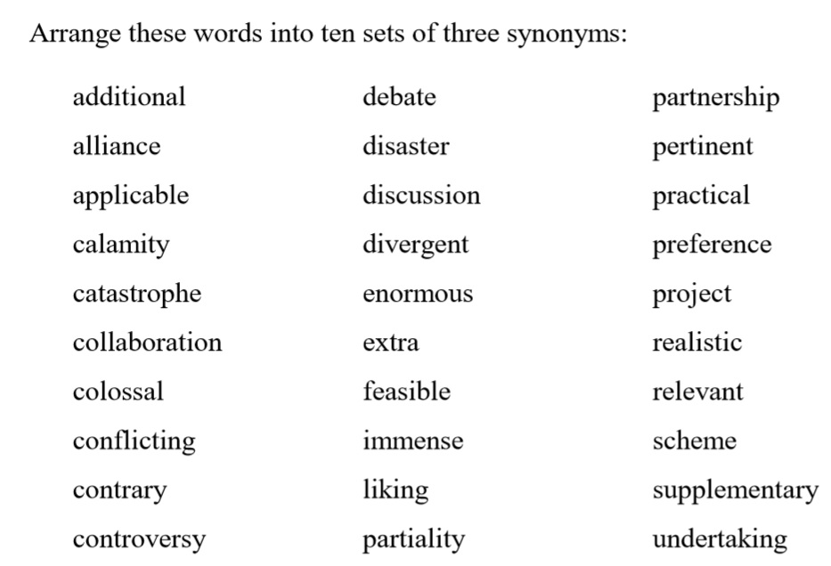
Activity 5.18 (p.38)

Slide 47
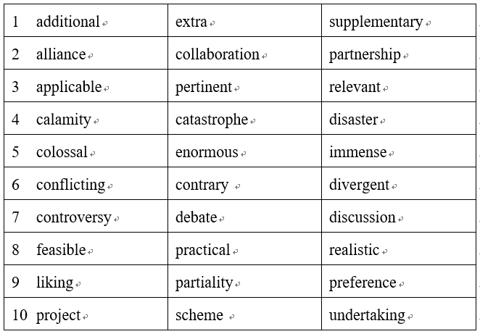
Activity 5.18 (Suggested key)

Slide 48
E205F Preparing for IELTS Unit 5 (Task 2) 3
Hazal WONG
hatwong@ouhk.edu.hk

Slide 49
Knowing which words go together (p.39)
Another aspect of vocabulary that deserves attention is collocation, knowing which words commonly go together.
The principal ones are verb–noun collocations (‘make a bed’), adjective–noun ones (‘great disappointment’) and adverb–adjective ones (‘totally wrong’).
Their use makes a piece of writing seem not only correct but polished and natural.

Slide 50
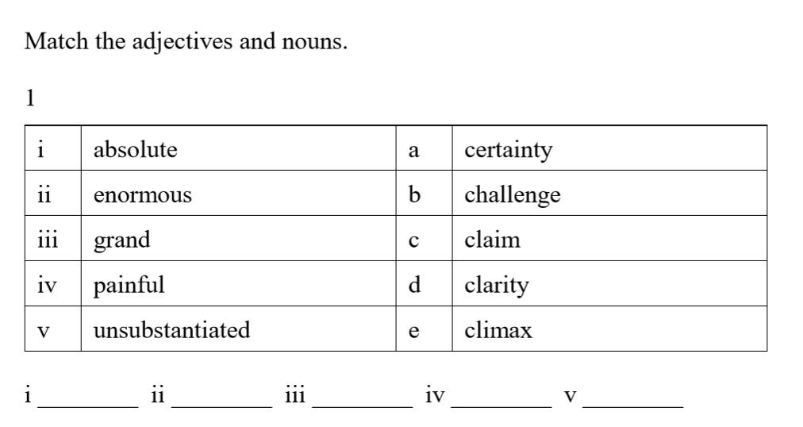
Activity 5.20 (p.40)
2 minutes individual
a
b
e
d
c

Slide 51
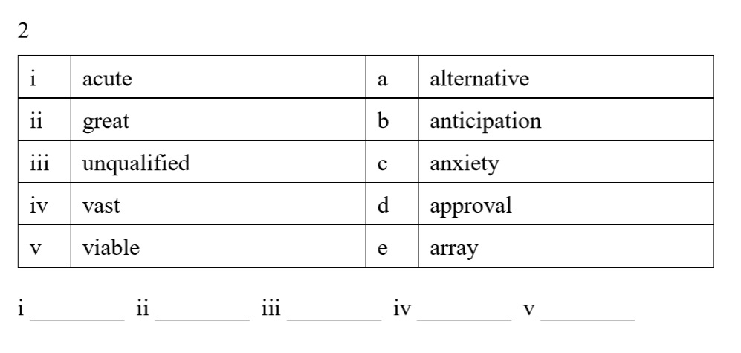
Activity 5.20 (p.40)
2 minutes individual
c
b
d
e
a

Slide 52
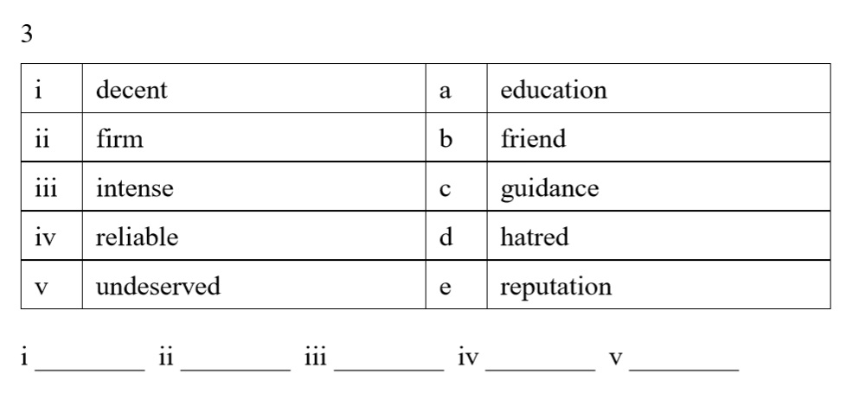
Activity 5.20 (p.40)
2 minutes individual
a
c
d
b
e

Slide 53
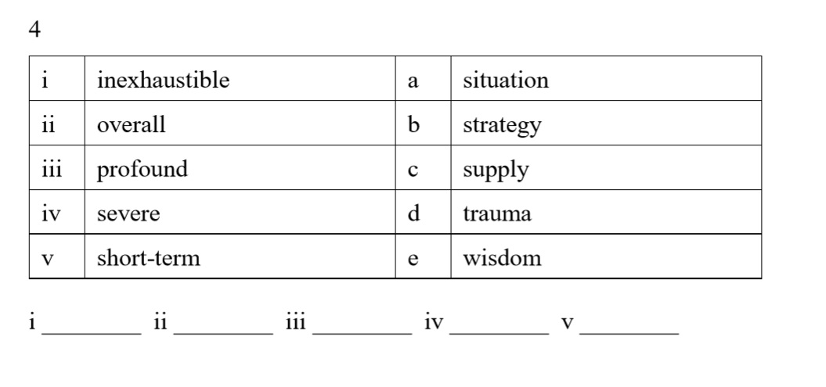
Activity 5.20 (p.40)
Q5-8 – TAKE HOME PRACTICE
2 minutes individual
c
a
e
d
b

Slide 54
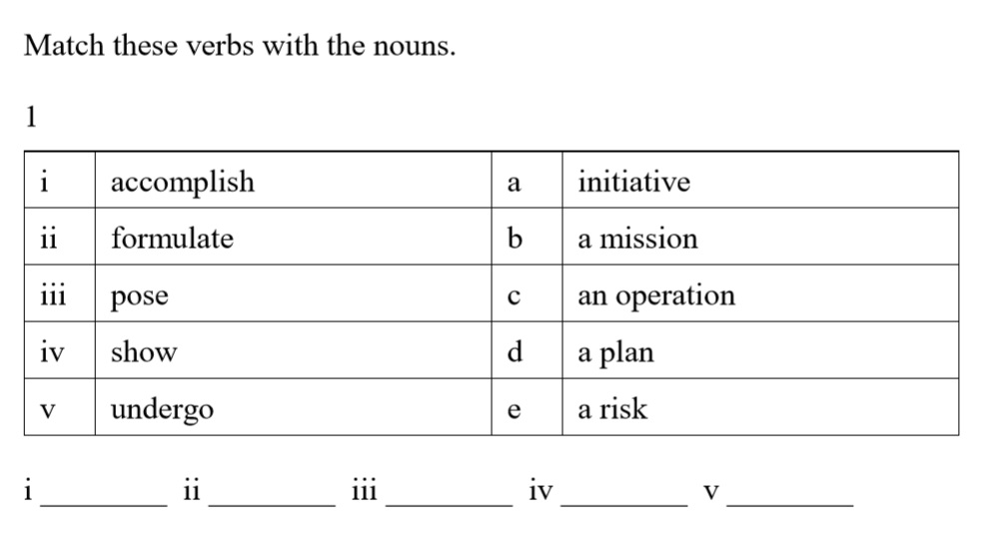
Activity 5.21 (p.42)
2 minutes individual
b
d
e
a
c

Slide 55
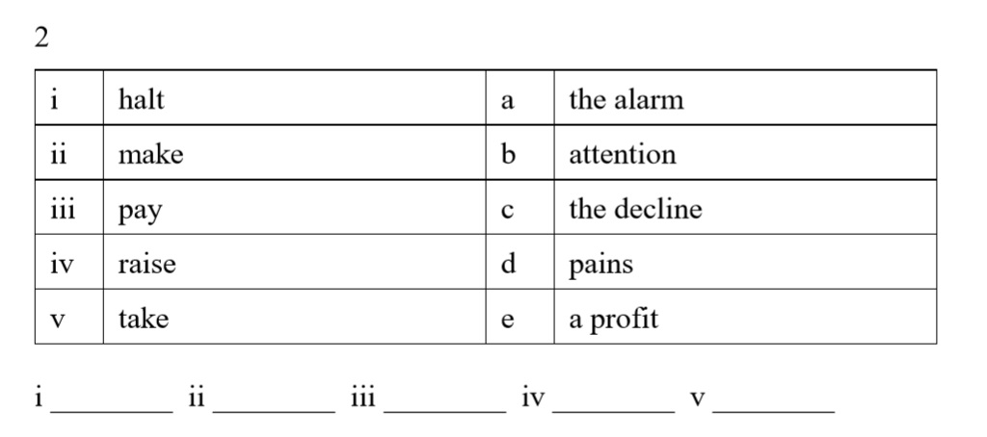
Activity 5.21 (p.42)
Q3-4 – TAKE HOME PRACTICE
2 minutes individual
c
e
b
a
d

Slide 56
Elegance and range of reference (p.43; selective)
Sentence lengths should not be too uniform.
It can be very effective to follow some long complex sentences with a short one that almost dramatically makes an important point:
Universities have opened their doors to commercial investment and actively seek out business partnerships. Courses have become ever more practical and geared to the marketplace, luring students with the hope of lucrative careers and prestigious posts. This is all wrong.

Slide 57
Elegance and range of reference (p.44; selective)
DON’T OVERUSE THOUGH
While it must not be overused or allowed to become noticeable, the repetition of sounds adds a certain music. In the above, ‘luring’ and ‘lucrative’ fit together rather well, and so do the words ‘prestigious posts’.
A rhetorical question can be effective, but one should perhaps limit oneself to one per essay (e.g. ‘Would we not need to rethink our attitudes towards other animals if we met a species far superior to ourselves?).
Metaphors and similes are also elegant if used in moderation. Care needs to be taken not to mix metaphors (e.g. ‘As we are all in the same boat when it comes to the environment, we need to forge closer ties’).

Slide 58
Elegance and range of reference (p.44; extra)
Sophisticated punctuation (the less-used colon and semi-colon) might be expected in writing worthy of the higher grades.
We can divide the new into two kinds; hard news and soft news.
☑ We can divide the new into two kinds: hard news and soft news.
 The diet was not very effective, therefore, he did not lose any weight.
☑ The diet was not very effective. Therefore, he did not lose any weight.
☑ The diet was not very effective; therefore, he did not lose any weight.

Slide 59
Elegance and range of reference (p.44; extra)
Slightly unusual effects, if used unobtrusively and correctly, can add a little polish, e.g. inversion and double negatives:
Under no circumstances can we tolerate this.
Seldom has there been such unashamed plunder of the Earth’s resources.
Not for nothing did they die.
Adverbial
Aux
S
V
O

Slide 60
Elegance and range of reference (p.45)
Finally, we have already emphasized the importance of well-constructed paragraphs and of logical connectors or discourse markers to organize and make your writing cohesive.
In order to gain maximum benefit from the final activity, try to do it under examination conditions.
In other words, give yourself only 40 minutes to complete the first draft of each essay, the same amount of time that you will have in the IELTS Academic Writing test.

Slide 61
Activity 5.23 (p.45)
Write an essay of at least 250 words for one of the following topics:
(For your practice)
1 Different societies have had different attitudes towards the taking of one’s own life. What are your views on suicide? Is it ever justified?
2 Some people think that the human race is doomed and will not last much longer. Do you agree or disagree with this gloomy scenario?
3 Some people fear that machines will become so intelligent that they will one day replace us. Do you think this is likely or not?
4 Parents drive their children to achieve academic success. Is such achievement really necessary to success in life? Explain and justify your opinion on this question.

Slide 62

Extra In-class Practice (not in your notes)
I have sent the soft copy of this practice to you via email.
Do it on the spot together if you don’t have the hard copy.
Argument writing topic:
Today, more and more students are deciding to move to a different country for higher studies. Do you think that the benefits outweigh the drawbacks?
You should write at least 250 words.

Slide 63
Currently, more and more students decide to have their further study other than their own country. Overseas studies for higher studies are _____________ opportunities for students to broaden their horizons and equip themselves _____________ the best education ________________. Reasons will be discussed in the following.
Students who study abroad can enhance their competitive _______________ for future career. Nowadays, English is a global language and important to all of us. It is not only an ability, but also a ________________ for us to apply for a job. Since England, America and Australia are the most popular _______________, students can also _______________ up the culture of English-speaking country and improve English at the same time. It helps them to have a good preparation before entering the society.
precious
with
possible
edge
requirement
destinations
soak

Slide 64
Besides, most of the students will live with the host family or other students in ____________, therefore they can learn to be more independent and __________ their social circles. They can try to talk to the ____________, instead of staying with their common friends. In recent years, there are many terms called “monster parents” or “_______________ parents” in the society, which refers to the parents who are too _____________ for their children. As a result, it is a golden opportunity for next generation to leave their comfort zone through overseas study.
dormitory
widen
locals
helicopter
protective

Slide 65
On the other hand, students can ____________ themselves in another country and sample the _____________ of other cultures and experiencing the cultural differences. For example, I went to Canada and experienced a summer course under a different ___________ of learning there. I learnt more about western culture and tried various activities, such as skiing and rock climbing, which I have never ________ told and tried in Hong Kong. Consequently, overseas study is a new experience for students to develop a new understanding of the different culture.
immerse
uniqueness
mode
been

Slide 66
However, some parents are ___________ study aboard because they argue that staying for a long period of time costs a large sum of money. It is suggested that students ______________ in overseas study try their best to study hard and a lot of schools provide scholarship to non-local students too. The most important thing is they can get more opportunities after ______________. Therefore, I think that the benefits of studying aboard for higher studies ____________ the drawbacks.
(380 words)
against
engaging
graduation
outweigh

Slide 67
Practices for revision
Student samples of the consultation writings and some more practices for your revision will be sent to you by email after this lesson.

Slide 68

We are done for Unit 5!
Please email me if you have anything you are unsure of.

